Slide 1
Linked List
By Vandana Goyal
Visiting Faculty IITM

Slide 2
Introduction
Linked List Concept:
A linked list is a non-sequential collection of data items. It is a dynamic data structure. For every data item in a linked list, there is an associated pointer that would give the memory location of the next data item in the linked list.
The data items in the linked list are not in consecutive memory locations. They may be anywhere, but the accessing of these data items is easier as each data item contains the address of the next data item.

Slide 3
Advantages of linked lists:
Linked lists have many advantages. Some of the very important advantages are:
1. Linked lists are dynamic data structures. i.e., they can grow or shrink during the execution of a program.
2. Linked lists have efficient memory utilization. Here, memory is not pre-allocated. Memory is allocated whenever it is required and it is de-allocated (removed) when it is no longer needed.
3. Insertion and Deletions are easier and efficient. Linked lists provide flexibility in inserting a data item at a specified position and deletion of the data item from the given position.
4. Many complex applications can be easily carried out with linked lists.
Disadvantages of linked lists:
1. It consumes more space because every node requires a additional pointer to store address of the next node.
2. Searching a particular element in list is difficult and also time consuming.

Slide 4
Arrays and Linked List
Arrays | Linked List
Size of an array is fixed | Size of a list is not fixed
Memory is allocated statically | Memory is allocated dynamically
It is necessary to specify the number of elements during declaration (i.e., during compile time). | It is not necessary to specify the number of elements during declaration (i.e., memory is allocated during run time).
It occupies less memory than a linked list for the same number of elements. | It occupies more memory because of pointers storage.
Inserting new elements at the front is potentially expensive because existing elements need to be shifted over to make room. | Inserting a new element at any position can be carried out easily.

Slide 5
Applications of linked list:
Linked lists are used to represent and manipulate polynomial. Polynomials are expression containing terms with non zero coefficient and exponents. For example: P(x) = a0 Xn + a1 Xn-1 + …… + an-1 X + an
2. Represent very large numbers and operations of the large number such as addition, multiplication and division.
Linked lists are to implement stack, queue, trees and graphs.
Implement the symbol table in compiler construction.

Slide 6
Memory Representation
Let LIST is linear linked list. It needs two linear arrays for memory representation. Let these linear arrays are INFO and LINK. INFO[K] contains the information part and LINK[K] contains the next pointer field of node K. A variable START is used to store the location of the beginning of the LIST and NULL is used as next pointer sentinel which indicates the end of LIST. It is shown below:

Slide 7
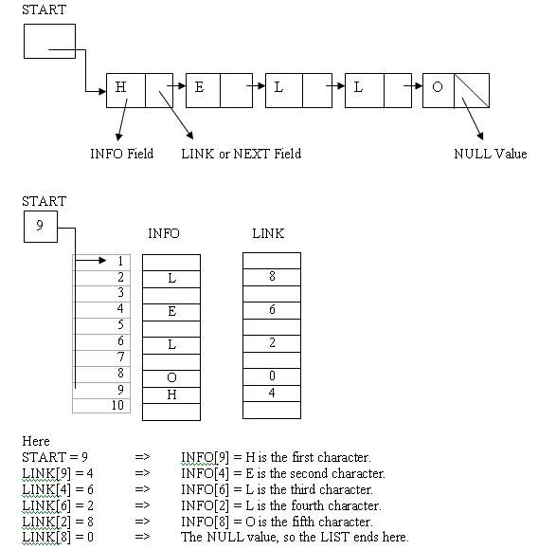

Slide 8
Dynamic Memory Allocation
malloc() is a system function which allocates a block of memory in the "heap" and returns a pointer to the new block. The prototype of malloc() and other heap functions are in stdlib.h. malloc() returns NULL if it cannot fulfill the request. It is defined by:
void *malloc (number_of_bytes)
Since a void * is returned the C standard states that this pointer can be converted to any type. For example
char *cp;
cp = (char *) malloc (100);
Attempts to get 100 bytes and assigns the starting address to cp. We can also use the sizeof() function to specify the number of bytes. For example,
int *ip;
ip = (int *) malloc (100*sizeof(int));

Slide 9
Types of Linked List
Basically we can put linked lists into the following four items:
1. Single Linked List.
2. Double Linked List.
3. Header Linked List.

Slide 10
Single Linked List:
A linked list allocates space for each element separately in its own block of memory called a "node". The list gets an overall structure by using pointers to connect all its nodes together like the links in a chain. Each node contains two fields; a "data" field to store whatever element, and a "next" field which is a pointer used to link to the next node. Each node is allocated in the heap using malloc(), so the node memory continues to exist until it is explicitly de-allocated using free(). The front of the list is a pointer to the “start” node.
The beginning of the linked list is stored in a "start" pointer which points to the first node. The first node contains a pointer to the second node. The second node contains a pointer to the third node, ... and so on. The last node in the list has its next field set to NULL to mark the end of the list. Code can access any node in the list by starting at the start and following the next pointers.

Slide 11
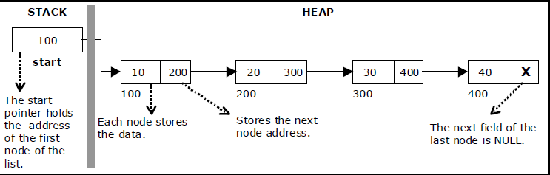
Single Linked List

Slide 12
Operations in a single linked list
The basic operations in a single linked list are:
• Travesing.
• Insertion.
• Deletion.
• Searching.

Slide 13
1. Traversing
C function for traversal of a linked list :
struct node {
int data;
struct node *next;
};
// This function prints contents of linked list starting from the given node
void traverse()
{
struct node *t;
t = start;
if (t == NULL) {
printf("Linked list is empty.\n");
return;
}
while (t->next != NULL)
{
printf("%d\n", t->data);
t = t->next;
}
printf("%d\n", t->data);
}

Slide 14
2. Insertion
One of the most primitive operations that can be done in a singly linked list is the insertion of a node. Memory is to be allocated for the new node (in a similar way that is done while creating a list) before reading the data. The new node will contain empty data field and empty next field. The data field of the new node is then stored with the information read from the user. The next field of the new node is assigned to NULL. The new node can then be inserted at three different places namely:
Inserting a node at the beginning.
Inserting a node at the end.
Inserting a node at specified position.

Slide 15
Inserting a node at the beginning:
The following steps are to be followed to insert a new node at the beginning of the list:
Get the new node from Free List
If the list is empty then start = newnode.
If the list is not empty, follow the steps given below:
newnode -> next = start;
start = newnode;
Figure shows inserting a node into the single linked list at the beginning

Slide 16
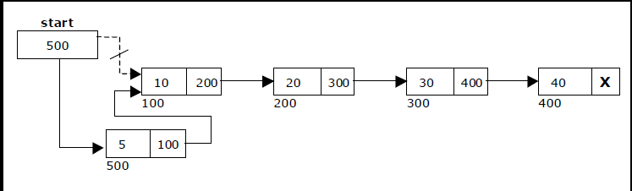

Slide 17
C Function for Inserting at Beg:
void insert_at_begin(int x) {
struct node *t;
t = (struct node*)malloc(sizeof(struct node));
if (start == NULL) {
start = t;
start->data = x;
start->next = NULL;
return;
}
t->data = x;
t->next = start;
start = t;
}

Slide 18
Inserting a node at the end:
The following steps are followed to insert a new node at the end of the list:
Get the new node from free list
If the list is empty then start = newnode.
If the list is not empty follow the steps given below:
temp = start;
while(temp -> next != NULL)
temp = temp -> next;
temp -> next = newnode;
Fig. shows inserting a node into the single linked list at the end.

Slide 19
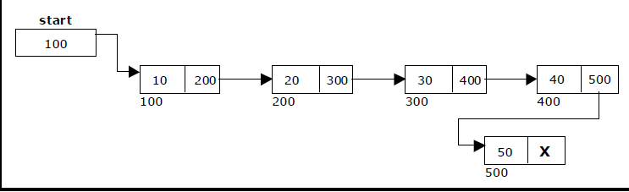

Slide 20
C Function for Insertion at End:
void insert_at_end (int x) {
struct node *t, *temp;
t = (struct node*)malloc(sizeof(struct node));
if (start == NULL) {
start = t;
start->data = x;
start->next = NULL;
return;
}
temp = start;
while (temp->next != NULL)
temp = temp->next;
temp->next = t;
t->data = x;
t->next = NULL;
}

Slide 21
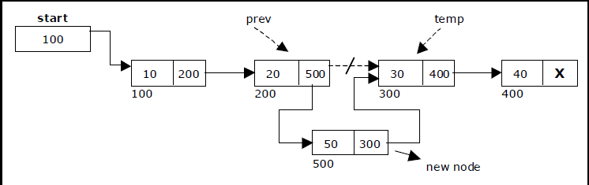
Insertion at Specified Position

Slide 22
C Function to insert at specified position:
Void insert_at_loc (int x, int loc)
{
struct node *t, *temp;
t = (struct node*)malloc(sizeof(struct node));
t->data = x;
struct node *temp = start;
for(int i=2; i < loc; i++)
{
if(temp->next != NULL)
temp = temp->next;
}
t->next = temp->next;
temp->next = t;
}

Slide 23
3.Deletion
Deletion of a node:
Another primitive operation that can be done in a singly linked list is the deletion of a node. Memory is to be released for the node to be deleted. A node can be deleted fromthe list from three different places namely.
Deleting a node at the beginning.
Deleting a node at the end.
Deleting a node at specified position.

Slide 24
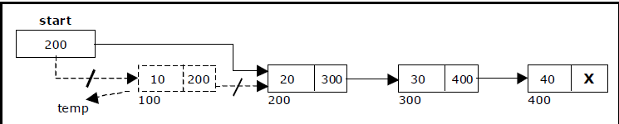
Deletion at Beg: The following steps are followed, to delete a node at the beginning of the list: If list is empty then display ‘Empty List’ message. If the list is not empty, delete the first node. Figure shows deleting a node at the beginning of a single linked list.

Slide 25
C Function for deletion at beg:
void delete_from_begin()
{
struct node *t;
int n;
if (start == NULL) {
printf("Linked list is already empty.\n");
return;
}
n = start->data;
t = start->next;
free(start);
start = t;
printf("%d deleted from beginning successfully.\n", n);
}

Slide 26
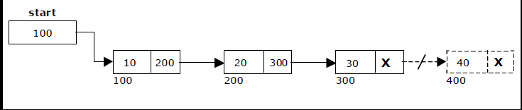
Deletion at End:
Deletion at End:
The following steps are followed to delete a node at the end of the list:
If list is empty then display ‘Empty List’ message.
If the list is not empty, traverse till last node and perform delete operation.
Fig shows deleting a node at the end of a single linked list.

Slide 27
C Function for deletion at End:
void delete_from_end() {
struct node *t, *u;
int n;
if (start == NULL) {
printf("Linked list is already empty.\n");
return;
}
if (start->next == NULL) {
n = start->data;
free(start);
start = NULL;
printf("%d deleted from end successfully.\n", n);
return;
}
t = start;
while (t->next != NULL) {
u = t;
t = t->next;
}
n = t->data;
u->next = NULL;
free(t);
printf("%d deleted from end successfully.\n", n);
}

Slide 28
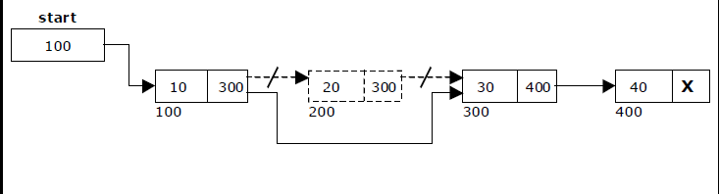
Deletion at specified Location:
Traverse to element before the element to be deleted
Change next pointers to exclude the node from the chain

Slide 29
C Function for Deletion at Loc:
Void delete_at_loc(int loc)
{
struct node *t, *u;
int n;
if (start == NULL) {
printf("Linked list is already empty.\n");
return;
}
if (start->next == NULL) {
n = start->data;
free(start);
start = NULL;
printf("%d deleted from end successfully.\n", n);
return;
}
t = start;
for(int i=2; i< loc; i++)
{ u = t;
t = t->next;
}
n = t->data;
u->next = t->next;
free(t);
printf("%d deleted from end successfully.\n", n);
}

Slide 30
Count number of nodes in Linked List
C Function :
int countNodes()
{
int count = 0;
struct node *temp;
temp = start;
while(temp != NULL)
{
count++; temp = temp->next;
}
return count;
}

Slide 31
Header Linked List
A Header linked list is one more variant of linked list. In Header linked list, we have a special node present at the beginning of the linked list. This special node is used to store the address of the first node of the list.
Types of Header linked list
Grounded header linked list: is a header list where the last node contain the null pointer.
Circular header linked list: is a header list where the last node points back to the header node.
More often , the information portion of such a node could be used to keep global information about the entire list such as number of nodes (not including the header) in the list count in the header node must be adjusted after adding or deleting the item from the list

Slide 32
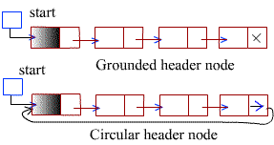

Slide 33
Two Way List/Doubly Linked List
Doubly Linked List (DLL) is a variation of Linked list in which navigation is possible in both ways, either forward and backward easily as compared to Single Linked List. Following are the important terms to understand the concept of doubly linked list.
Info − Each link of a linked list can store a data called an element.
Back − Each link of a linked list contains a link to the next link called Next.
FOrw − Each link of a linked list contains a link to the previous link called Prev.
A Linked List contains the special pointers to the first node called First and to the last node called Last.

Slide 34
Advantages over singly linked list
1) A DLL can be traversed in both forward and backward direction. 2) The delete operation in DLL is more efficient if pointer to the node to be deleted is given. 3) We can quickly insert a new node before a given node. In singly linked list, to delete a node, pointer to the previous node is needed. To get this previous node, sometimes the list is traversed. In DLL, we can get the previous node using previous pointer.
Disadvantages over singly linked list
1) Every node of DLL Require extra space for an previous pointer. It is possible to implement DLL with single pointer though. 2) All operations require an extra pointer previous to be maintained. For example, in insertion, we need to modify previous pointers together with next pointers.

Slide 35
1.Traversing
C Program to traverse a DLL: (Beg to End)
struct node
{ struct node *prev;
int data;
struct node *next;
};
void traversebeg()
{
struct node *temp;
temp =first;
if (temp == NULL)
{
printf("List empty to display \n"); return;
}
printf("\n Linked list elements from begining : ");
while (temp->next != NULL)
{
printf(" %d ", temp->n);
temp = temp->next;
}
printf(" %d ", temp->n);
}

Slide 36
C Program to traverse a DLL: (End to Beg)
struct node
{ struct node *prev;
int data;
struct node *next;
};
void traverseend()
{
struct node *temp;
temp =last;
if (temp == NULL)
{
printf("List empty to display \n"); return;
}
printf("\n Linked list elements from begining : ");
while (temp->prev != NULL)
{
printf(" %d ", temp->n);
temp = temp->prev;
}
printf(" %d ", temp->n);
}

Slide 37
2.Insertion
Insert_at_Beg:
void insertBeg(int x)
{
struct node *temp,*h;
temp = (struct node*)malloc(sizeof(struct node));
temp -> data=x;
h=first;
if (first == NULL)
{
first = temp;
temp->prev = NULL
temp->next = NULL;
}
else
{
temp->next = h;
temp->prev=NULL;
h->prev = temp;
first = temp;
}
}

Slide 38
Insert_at_End:
void insertEnd(int x)
{
struct node *temp,*h;
temp = (struct node*)malloc(sizeof(struct node));
temp -> data=x;
h=last;
if (first == NULL)
{
first = temp;
temp->prev = NULL
temp->next = NULL;
}
else
{
temp->next = NULL;
temp->prev = h;
h->next=temp;
last = temp;
}
}

Slide 39
3.Deletion
Delete from Beg:
void deleteBeg()
{
Int x;
struct node *temp,*h;
if (first == NULL)
{
printf(“\n Underflow: List is Empty”);
}
else
{
temp= first;
x= temp->data;
h=temp->next;
first-h;
h->prev=NULL;
free(temp);
}
}

Slide 40
Delete from End:
void deleteBeg()
{
Int x;
struct node *temp,*h;
if (first == NULL)
{
printf(“\n Underflow: List is Empty”);
}
else
{
temp= last;
x= temp->data;
h=temp->prev;
last = h;
h->next =NULL;
free(temp);
}
}

